Slide 1

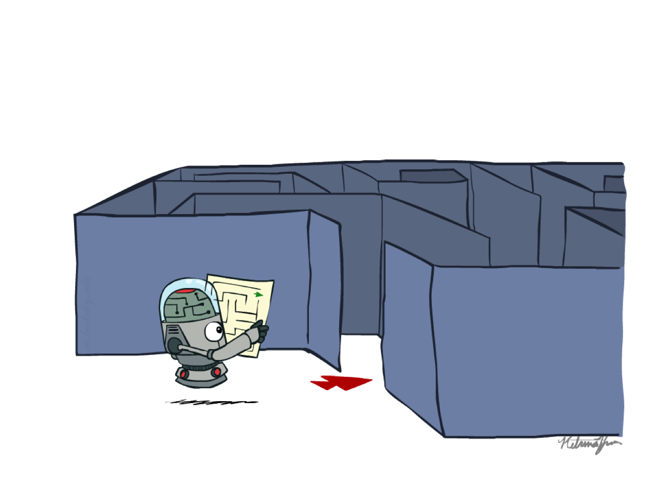
Chapter 1c
Local Search & CSP
COMP 7404C
Computational Intelligence and Machine Learning
K.P. Chow & Dirk Schnieders
Most materials in this chapter are based on materials from http://aima.cs.berkeley.edu/ and http://ai.berkeley.edu
http://ai.berkeley.edu

Slide 2
Outline
Abstraction
Types of Search
Search Problem Definition
State Space Graph vs. Search Tree
Search Algorithm (TSA, GSA)
Uninformed Search
BFS, DFS, UCS
Informed Search
Greedy, A*
Local Search
Constraint Satisfaction Problems
Adversarial Search
Minimax
DLS
Horizon Effect
𝛼-𝛽 Pruning
Expectimax
Multi-Agent Utilities

Slide 3
Local Search

Slide 4
Planning vs. Identification
Planning: sequences of actions
The path to the goal is the important thing
Paths have various costs, depths
Heuristics to guide, frontier to keep backups
Identification: assignments to variables
The goal itself is important, not the path
Local Search can find solutions faster for specific types of identification problems

Slide 5
Local Search
Evaluate and modify one current state rather than systematically explore paths from an initial state
Suitable for problems were all that matters is the solution state and not the path cost to reach it
Although local search algorithms are not systematic they have two advantages
Require very little memory
Often find reasonable solutions in large spaces

Slide 6
Example: 8-Queens
States
Each state has 8 queens on the board, one per column
Successors
All possible states generated by moving a single queen to another square in the same column
Cost function
Number of pairs of queens that are attacking each other

Slide 7
Example: 8-Queens
What is the cost of the following state?
 |  |  | Q₄
Q₁ |  |  |  | Q₅
 | Q₂ |  |  |  | Q₆ |  | Q₈
 |  | Q₃ |  |  |  | Q₇
Answer:
Consider unique attacks
Q₁ is attacking Q₂, Q₃, Q₅
Q₂ is attacking Q₃, Q₄, Q₆, Q₈
Q₃ is attacking Q₅, Q₇
Q₄ is attacking Q₅, Q₆, Q₇
Q₅ is attacking Q₆, Q₇
Q₆ is attacking Q₇, Q₈
Q₇ is attacking Q₈
The cost of the state is 17

Slide 8
Example: 8-Queens
How many neighbors does the following state have? (move 1 Q)
 |  |  | Q₄
Q₁ |  |  |  | Q₅
 | Q₂ |  |  |  | Q₆ |  | Q₈
 |  | Q₃ |  |  |  | Q₇
Answer:
Every queen can move to 7 locations
There are 7*8 = 56 neighbors
Q₁
Cost = 17 – 3 + 1 = 15

Slide 9
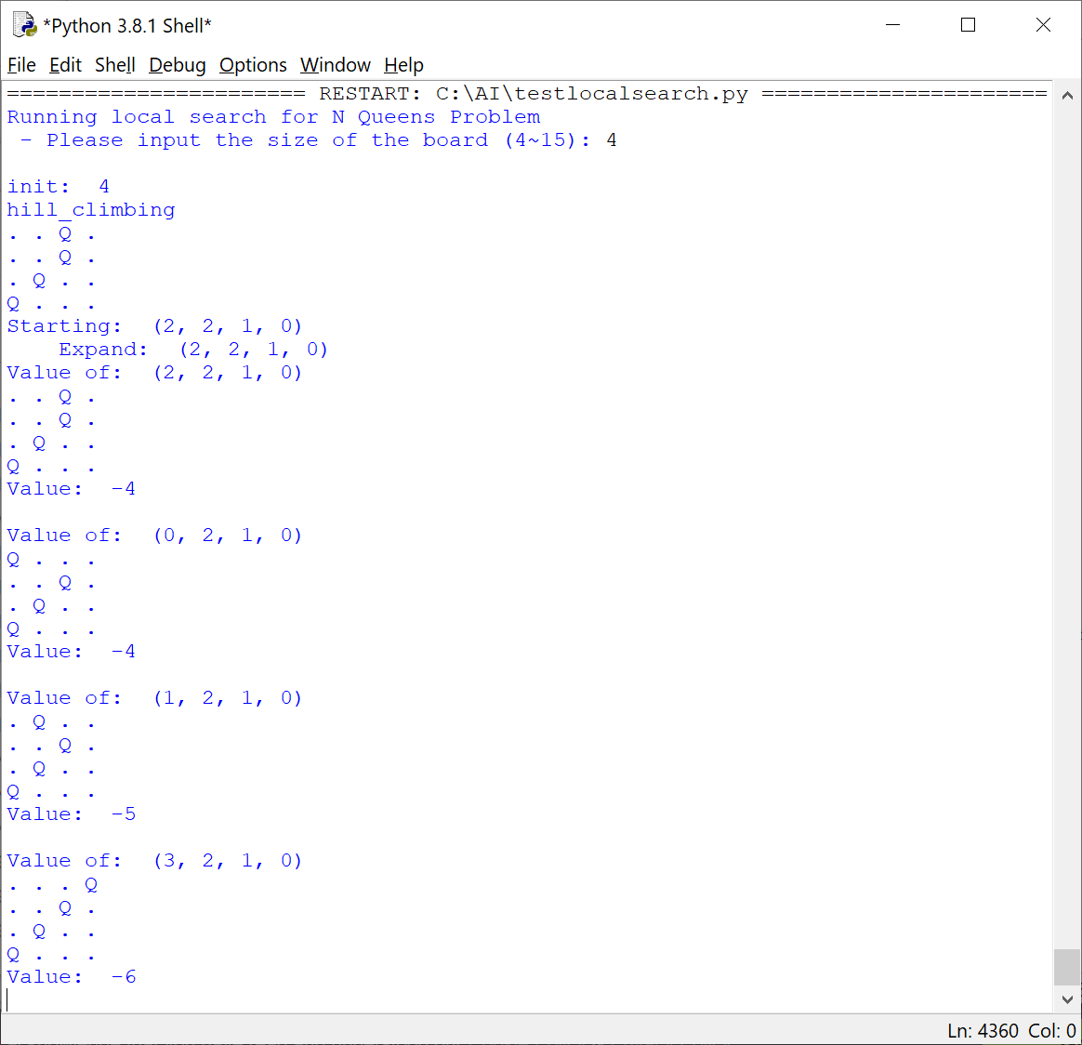
Sample run with 4 Queens
4 domain variables
(X1, X2, X3, X4):
X1 : row 1
X2 : row 2
X3 : row 3
X4 : row 4

Slide 10
Example: 8-Queens
Costs of all neighbors with minimas shown in red
18 | 12 | 14 | 13 | 13 | 12 | 14 | 14
14 | 16 | 13 | 15 | 12 | 14 | 12 | 16
14 | 12 | 18 | 13 | 15 | 12 | 14 | 14
15 | 14 | 14 | Q₄ | 13 | 16 | 13 | 16
Q₁ | 14 | 17 | 15 | Q₅ | 14 | 16 | 16
17 | Q₂ | 16 | 18 | 15 | Q₆ | 15 | Q₈
18 | 14 | Q₃ | 15 | 15 | 14 | Q₇ | 16
14 | 14 | 13 | 17 | 12 | 14 | 12 | 18
The cost of the state is 17
Move Q1 up (to row 4)
Cost = 17 – 3 + 1 = 15
Move Q1 to row 3
Cost = 15 – 1 = 14
…

Slide 11
Local Search - Algorithm
Randomly initialize currentState
If cost of currentState == 0 return currentState
If min(cost(getNeighbors(currentState))) > cost(currentState)
goto step 1 (we have reached a local minimum)
Select cheapest neighbor as currentState and goto step 2

Slide 12
Example: 8-Queens
Starting from a randomly generated 8-queens state, local search gets stuck 86% of the time, solving only 14% of problem instances
It just takes 4 steps on average when it succeeds and 3 when it gets stuck
This is remarkable considering the huge state space

Slide 13
Constraint Satisfaction Problems

Slide 14
Constraint Satisfaction Problems
CSPs use a factored representation for states
A set of variables, each of which has a value
A problem is solved when each variable has a value that satisfies certain constraints
CSPs can often be solved more efficiently
They eliminate large portions of the search space by identifying variable/value combinations that violate constraints

Slide 15
Defining CSPs
A CSP consists of three components
A set of variables, X = {X₁, ... , X_{n}}
A set of domains, D = {D₁, ... , D_{n}}, where D_{i} = {v₁, ... , v_{k}} for each variable X_{i}
A set of constraints C which specify allowable combinations of values
To solve a CSP we need to define a state space
Each state is defined by an assignment of values to some or all variables {X_{i} = v_{i}, X_{j} = v_{j}, ...}

Slide 16
Solutions to CSPs
If no constraints are violated we call the assignment consistent
If every variable is assigned we call the assignment complete
A solution is an assignment that is both consistent and complete

Slide 17
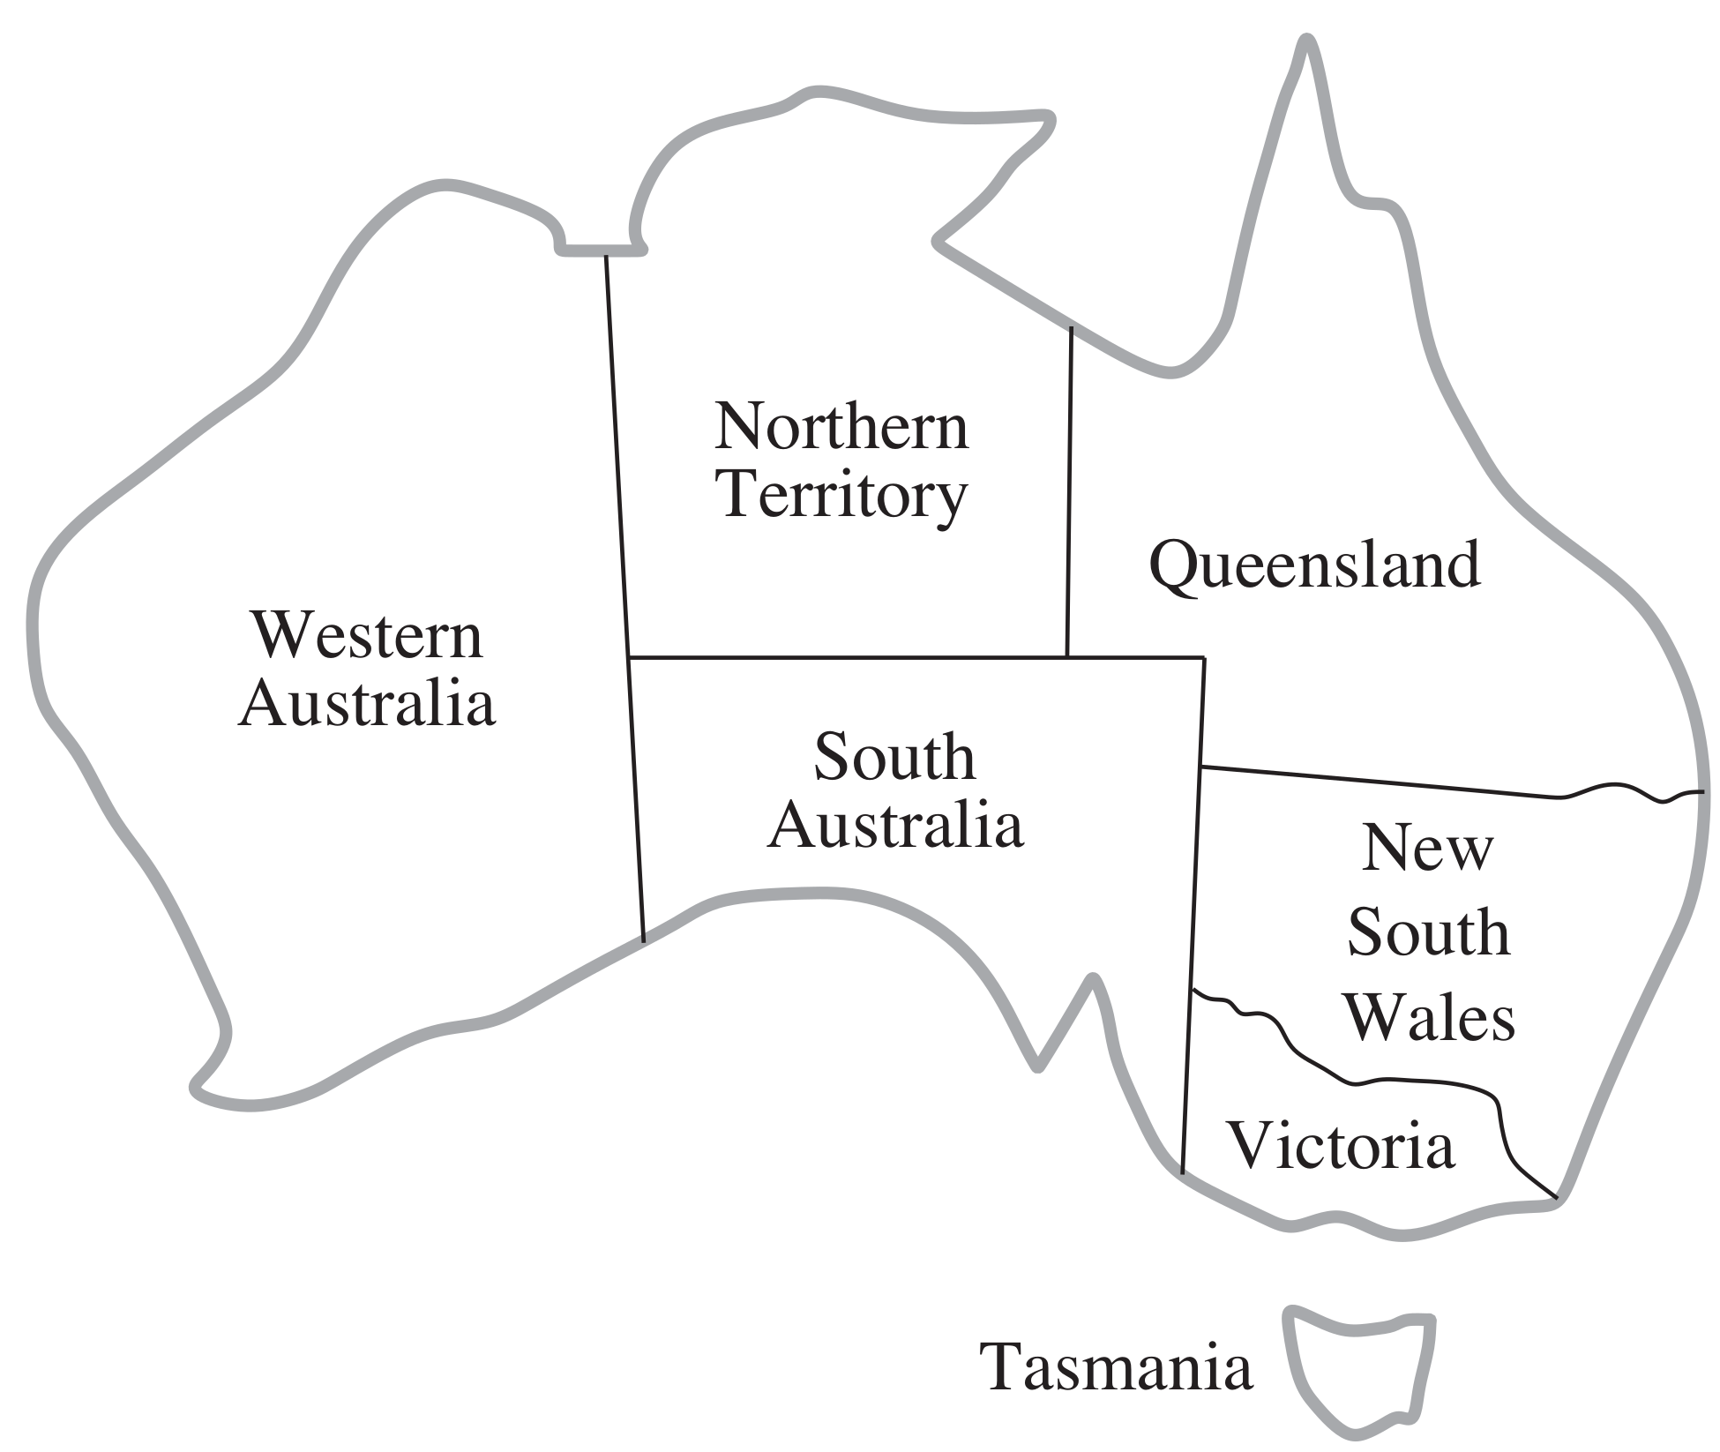

Example: Australia - Map Coloring
http://aima.cs.berkeley.edu/
Variables
X = {WA, NT, Q, NSW, V, SA, T}
Domains
D = {red, green, blue}
Constraints (different colors for neighbors)
Implicit
C = {SA != WA, ...}
Explicit
C = {(SA, WA) in {(red, green), ...}}
http://ai.berkeley.edu

Slide 18
Constraint Graph
http://aima.cs.berkeley.edu/
It can be helpful to visualize a CSP as a constraint graph
Nodes correspond to variables
Arcs show existence of constraints
NT
Q
WA
SA
NSW
T
V

Slide 19
Solving CSPs
Let’s start with a naive approach
States are defined by the values assigned so far
Initial state
Empty assignment { }
Successor function
Assign a value to an unassigned variable
Goal test
Current assignment is complete and consistent

Slide 20
BFS
D = {red, green, blue}
X = {WA, NT, Q, NSW, V, SA, T}
http://aima.cs.berkeley.edu/
. . .
. . .
. . .
. . .
This calls for DFS :-)
Note that all solutions will be at the bottom of this search tree :-(

Slide 21
DFS
D = {red, green, blue}
X = {WA, NT, Q, NSW, V, SA, T}
http://aima.cs.berkeley.edu/
. . .
. . .
Early mistake ...
. . .
. . .
. . .

Slide 22

Backtracking Search
The basic algorithm for solving CSPs
Idea
Only consider assignments to a single variable at each point
Note that variable assignments are commutative
Therefore, we need only consider a single variable at each node
Only allow legal assignments at each point
Consider only values which do not conflict previous assignments
Incremental goal test
DFS with these two ideas is called backtracking search
http://ai.berkeley.edu

Slide 23
Backtracking
. . .
D = {red, green, blue}
X = {WA, NT, Q, NSW, V, SA, T}

Slide 24
Example: Backtracking
NT
NT
NT
NT
NT
NT
Q
Q
Q
Q
Q
Q
Q
Q
Q
Q
Q
WA
WA
WA
NSW
SA
NSW
SA
SA
SA
SA
SA
SA
SA
SA
SA
SA
SA
V
V
V
T
T
D = {red, green, blue}
X = {NSW, WA, NT, Q, SA, V, T}

Slide 25
Improving Backtracking
Idea
Can we detect inevitable failure early?
Forward checking (FC)
Constraint propagation (AC-3)

Slide 26
Filtering: Forward Checking
http://aima.cs.berkeley.edu/
[WA,Q,V,…]
Filtering
Keep track of domains for unassigned variables and cross off bad options
Forward checking
Cross off values that violate a constraint when added to the existing assignment
Detect failure earlier
WA | NT | Q | NSW | V | SA | T

Slide 27
Example: Backtracking + Forward Checking
NT
NT
NT
NT
NT
Q
Q
Q
Q
Q
Q
WA
WA
WA
NSW
NSW
SA
NSW
SA
V
V
T
T
D = {red, green, blue}
X = {NSW, WA, NT, Q, SA, V, T}

Slide 28
Filtering: Forward Checking
http://aima.cs.berkeley.edu/
[WA,Q,V,…]
Filtering
Keep track of domains for unassigned variables and cross off bad options
Forward checking
Cross off values that violate a constraint when added to the existing assignment
Can we detect this earlier?
Doomed to fail
WA | NT | Q | NSW | V | SA | T

Slide 29
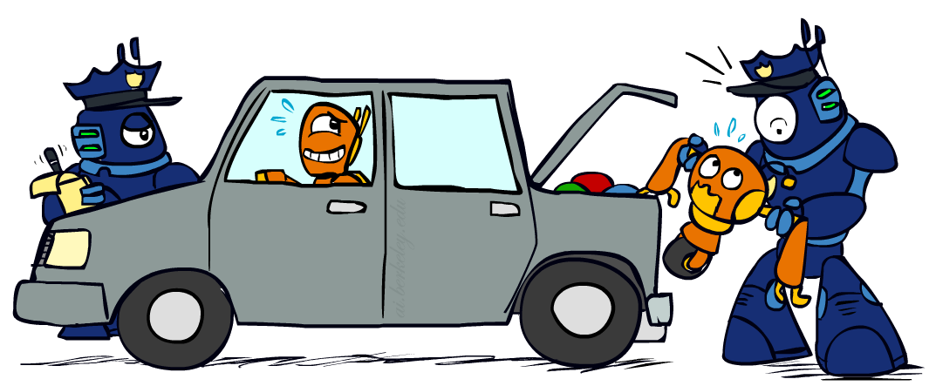
Consistency of an Arc
http://ai.berkeley.edu
Delete from tail!
An arc X ⟶ Y is consistent iff for every x in the tail there is some y in the head which could be assigned without violating a constrain
WA | NT | Q | NSW | V | SA | T
Arc consistency explained by Prof. Alan Mackworth

Slide 30
Constraint propagation
http://ai.berkeley.edu
Delete from tail!
Constraint propagation repeatedly enforces constraints
Note
Arcs can become inconsistent
If X loses a value, neighbors of X need to be rechecked
Arc consistency detects failure earlier than forward checking
Can be run as a preprocessor or after each assignment
http://aima.cs.berkeley.edu/
WA | NT | Q | NSW | V | SA | T
An arc X ⟶ Y is consistent iff for every x in the tail there is some y in the head which could be assigned without violating a constrain

Slide 31
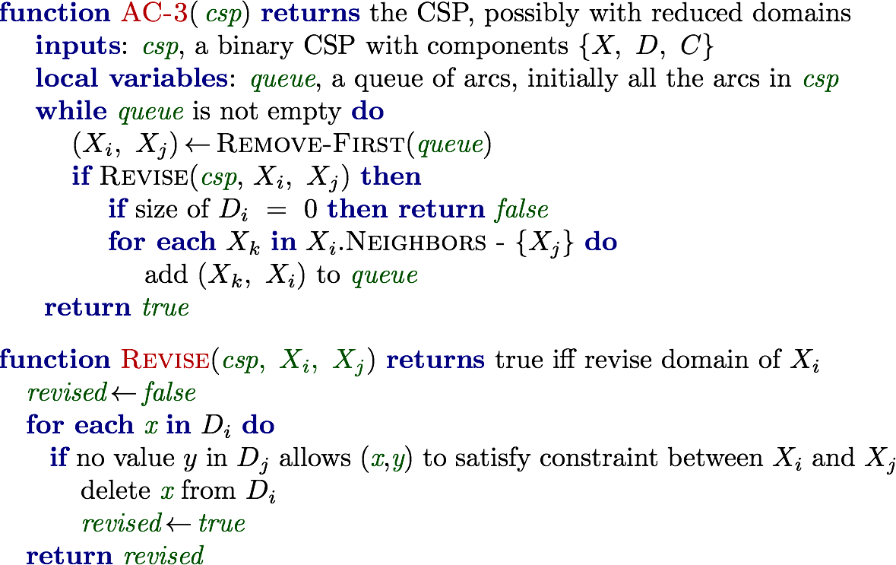
AC-3 to Enforce Arc Consistency
Why - { X_{j} } ?

Slide 32
Why - { X_{j} } ?
Xk1
Xk2
Xk3
Let xi have 4 neighbors (incl Xj)
= Xk4
Xi
Xj
Assume we update the domain of Xi
Why don’t I have to add this one ?
AC-3 was developed by him in 1977
Explained by Prof. Alan Mackworth

Slide 33
Example: Backtracking + AC-3
NT
NT
NT
NT
NT
Q
Q
WA
WA
WA
NSW
SA
NSW
SA
V
V
T
T
D = {red, green, blue}
X = {NSW, WA, NT, Q, SA, V, T}

Slide 34
Improving Backtracking Further
Variable Ordering
Minimum remaining values (MRV)
Choose the variable with the fewest legal left values in its domain
Most constrained variable
Fail-first heuristic
Tie-breaker among MRV variables
Degree Heuristic (Deg)
Choose the variable with the most constraints on remaining variables
Value Ordering
Least constraining value (LCV)
Choose the value that rules out the fewest values in the remaining variables

Slide 35
Variable Ordering (MRV)
Minimum remaining values
Choose the variable with the fewest legal left values in its domain
Most constrained variable
Fail-first heuristic
using forward checking
D = {red, green, blue}
X = {WA, NSW, NT, Q, SA, V, T}

Slide 36
Variable Ordering (MRV + Deg)
Degree Heuristic (Deg)
Choose the variable with the most constraints on remaining variables
using forward checking
D = {red, green, blue}
X = {NSW, WA, NT, Q, SA, V, T}

Slide 37
Value Ordering (LCV)
Choose the value that rules out the fewest values in the remaining variables
Least constraining value (LCV)
Suppose we have decided to assign this variable next.
What value should we try first?

Slide 38
Example: Backtracking +AC-3 + MRV & Deg + LCV
NT
NT
Q
Q
WA
WA
NSW
SA
NSW
SA
V
V
T
T
D = {red, green, blue}
X = {NSW, WA, NT, Q, SA, V, T}

